Slide 1

Python in Mantid

Slide 2
Python Basics
Variable assignment in Python is simpler than in other languages as you do not specify types
  x = 5; x += 1; x = ‘a string’
Some operations are not possible with certain types
  ‘a string’ + 5 → TypeError: cannot concatenate 'str' and 'int' objects

Slide 3
Python Basics
To convert objects to a string use the str() function
  x = 42
  “The answer is " + str(x)
Note that, in this case, str(x) is not the same as 'x'

Slide 4
Python Basics
Python uses indentation instead of brackets to separate code blocks
  for i in range(0, 5):
    print i
  fibs = [1,1,2,3,5]
  for i in fibs:
    print i

Slide 5
Executing Algorithms
Each Mantid algorithm has a corresponding Python function of the same name
The arguments of the function are the parameters of the algorithm
Execute the algorithm by simply calling the function
  Load('path-to-file','Result')

Slide 6
Executing Algorithms
mantidHelp() gives a list of the algorithms currently available
help(algorithm-name) shows help for the named algorithm
The result is information regarding the properties for the chosen algorithm

Slide 7
Combining Python and Mantid
Use Python to automate tasks
  rootdir = 'C:/MantidInstall/Data/'
  prefix = 'LOQ‘
  run_nums = [48098,48094,48130,48128]
  for run in run_nums:
  Load(rootdir + prefix + str(run) + '.raw', str(run))
Functions are useful when a set of operations is to be applied frequently

Slide 8
Using functions
def LoadAndConvert(filepath, output_workspace, final_unit): Load(filepath, output_workspace) ConvertUnits(output_workspace, output_workspace, final_unit)
rootdir = 'C:/MantidInstall/Data/'
prefix = 'LOQ'
run_nums = [48098,48094,48130,48128]
for run in run_nums:
LoadAndConvert(rootdir + prefix + str(run) + '.raw', str(run), 'dSpacing')
If an output workspace as the same name as an input, the input is overwritten

Slide 9
Exercise One
Steps:
  LoadEventNexus - Load the given POWGEN data set, PG3_4871 into a workspace named 'PG3_4871'. If you need to reduce the number of events loaded, select only the first 4000 seconds of the run.
  View the number of events with mtd.sendLogMessage.The function to get the number of events is 'getNumberEvents()'.
  FilterBadPulses - Remove events that occurred while the accelerator was resetting. You can view the logs by right clicking on the workspace and selecting 'Sample logs...'
  AlignDetectors - Convert to d-spacing using the supplied calibration file
  Rebin - Bin the data in d-spacing from 1.4 to 8 angstroms using logarithmic binning of .0004.
  DiffractionFocussing - Focus the data in the workspace using the same cal file as the previous step.
  CompressEvents - Saves some memory. Note the number of events again.

Slide 10
Script Generation
Every workspace created by an algorithm has a history associated with it
The history stores all of the information regarding the creation of the specified workspace, i.e. algorithms and property information.
This information can be used to generate a script to rerun the algorithms that created that workspace.

Slide 11
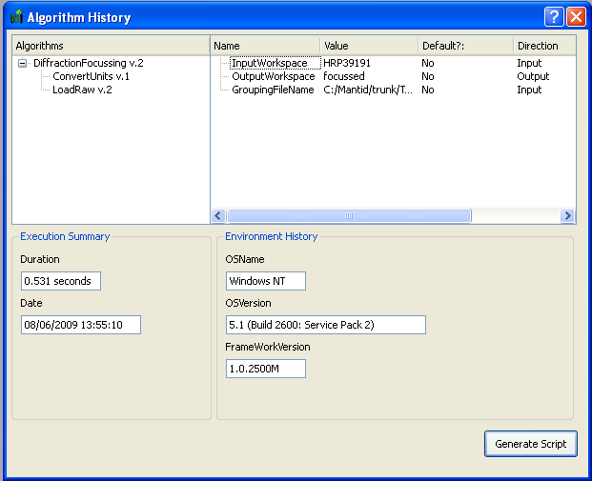
Script Generation
To view the history of a workspace in MantidPlot, right click on the entry within the Mantid Workspaces box and select Show History.

Slide 12
Generalising scripts
The script generated from the history window will be specific to the properties contained within it.
A more useful script will be able to handle different parameters with each run
Algorithm dialog boxes can be used from Python to ask for user input

Slide 13
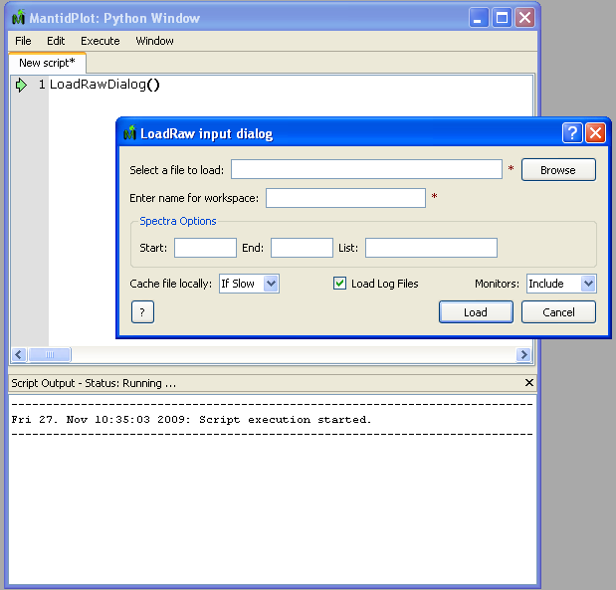
Generalising scripts
Every algorithm function also has a counterpart with the word ‘Dialog’ appended to it

Slide 14
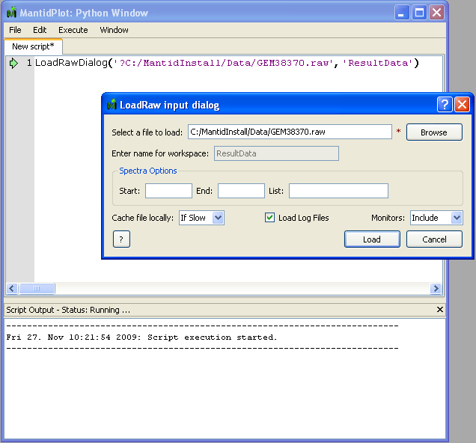
Generalising scripts
Suggested values are specified by prefixing the value with a ‘?’
Each dialog has an optional message parameter e.g.

Slide 15
Extracting property values
After an algorithm has been executed the properties remain available to access
Each function that runs an algorithm returns a handle to it. Use getPropertyValue on it to find the value
    alg = LoadRawDialog(OutputWorkspace=“test”)
    filename = alg.getPropertyValue(“Filename”)

Slide 16
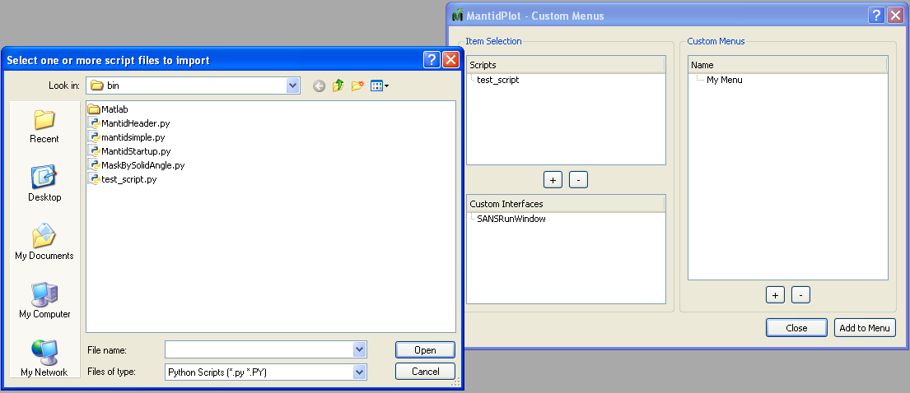
Custom Script Menus
Scripts can be executed more easily by adding them to a custom menu in MantidPlot
In MantidPlot click on 'Scripting->Manage Custom Mantid Menus...'

Slide 17
Exercise 2
Here you are going to perform a number of steps in the MantidPlot user interface to display the beam profile of EQ SANS
  LoadNexus - load the file EQSANS_6071_event_corrected.nxs.
  ConvertUnits - Convert the units for the workspace to wavelength
  Rebin - rebin the monitor from 2.5 to 5.5 in linear steps of 0.1
  SumSpectra - sum up all the detectors to give the beam profile
Perform the steps by hand and generate a script afterwards
Generalise the script

Slide 18
Exercise 2 cont’d
Generalising the script:
  Make the first LoadNexus command display a dialog so the user can input their desired file.
  Extract the selected filename from the LoadNexus command and print it to the screen with mtd.sendLogMessage("message").
  In the rebin - Allow the user to alter the rebin parameters, but provide them the ones you use as a default.
  Add messages to the dialog boxes displayed for LoadNexus and Rebin to tell the user what you want them to do.

Slide 19
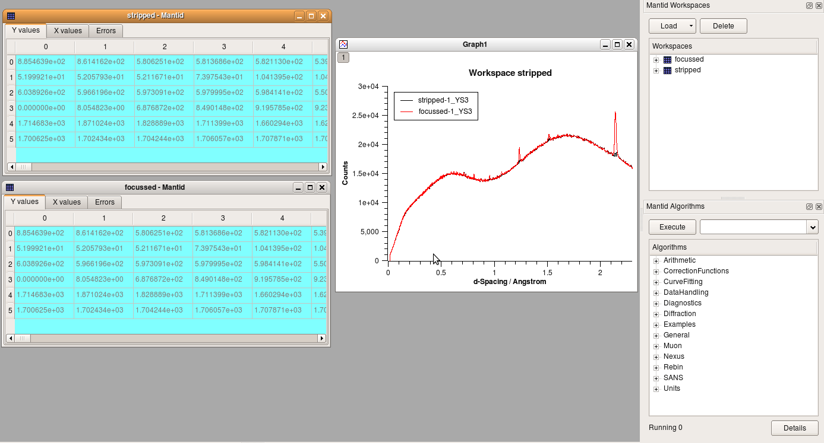
MantidPlot
MantidPlot is used to create tables and graphs of the data produced with Mantid
This can also be automated with Python

Slide 20
MantidPlot Control
To display a matrix of values use importMatrixWorkspace(“workspace-name”)
Interaction with graphs is through
  gs = plotSpectrum(‘workspace-name’, index)
  gt = plotBin(‘workspace-name’,index)
Multiple spectra/workspaces can be specified in lists
  gs = plotSpectrum('ws1',[0,1,2,3]) # and
  gs = plotSpectrum(['ws1','ws2'],[0,1])

Slide 21
Plot Properties
Various aspects of the plot display can be controlled, e.g.
    # Get the active layer of the the graph
    l = gs.activeLayer()
    # Rescale the x-axis to a show a smaller region
    l.setAxisScale(Layer.Bottom, 2.0, 2.5)
    # Retitle the y-axis
    l.setAxisTitle(Layer.Left, "Cross-section")
    # Put y-axis on a log scale
    l.setAxisScale(Layer.Left, 1, 1000, Layer.Log10)
    # Change the title of a curve
    l.setCurveTitle(0, "My Title")

Slide 22
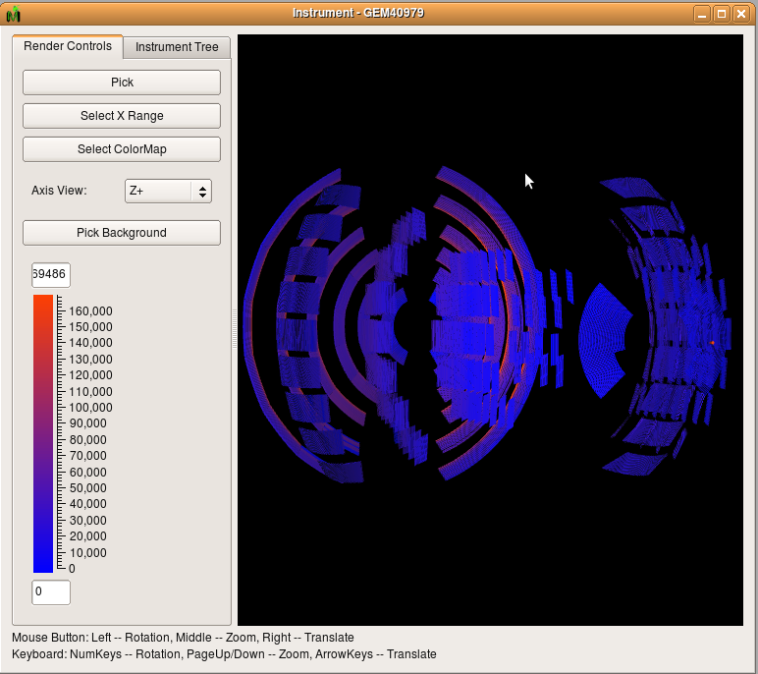
Instrument Window
The instrument view window renders the instrument in 3D

Slide 23
Instrument Window
In a script you can set properties of the window before it is raised
  instrument_window = getInstrumentView(“ws-name")
  instrument_window.setColorMapRange(0., 200.)
  instrument_window.setColorMap(“path-to-file”)
  instrument_window.showWindow()
  # Or select a component by name
  instrument_window.selectComponent(“name”)
  instrument_window.showWindow()

Slide 24
Exercise 3
Graphing
  Load the processed CNCS data file (Training_Exercise3a_SNS.nxs)
  Plot workspace index 0
  Merge the plot from index 1 with the first graph created
  Merge index 2 with the first graph also
  Rescale x-axis to range to -1.5 < x < 1.8
  Change the y-axis to have a log scale
Instrument view
  Load ARCS example data set (Training_Exercise3b_SNS.nxs)
  Get the instrument view
  Change the color map to BlackBodyRadiation.map (All of the colormap files can be found in C:\MantidInstall\colormaps)
  Set the colour map range to (0,2000)
  Show the window

Slide 25
Command Line
MantidPlot is just one way of ‘driving’ Mantid
Mantid can also be used from within a Python interpreter on the command line in one of two ways:
  Interactive mode: Each line of code executes as you press enter
  Script mode: Python executes a script from a separately written file

Slide 26
Command Line
Either mode requires using the MantidScript.bat file
For interactive mode:
  Change to C:\MantidInstall\bin
  Run MantidScript.bat --> This starts Python with Mantid embedded within it
For script mode:
  Change to C:\MantidInstall\bin
  Run MantidScript.bat name-of-script.py --> This runs the named script and then exits Python
As the script executes, output messages will appear on the command line

Slide 27
Accessing workspaces
To print a list of the available workspaces use the command mantid.list()
A handle to the workspace is retrieved by using
  wksp = mantid[‘name’]
'wksp' can be one of 3 flavours:
  MatrixWorkspace;
  TableWorkspace;
  WorkspaceGroup.

Slide 28
Accessing Workspaces
Alternatively, if algorithm is executed in Python use .workspace()
  wksp = Load('filepath','r').workspace()
  print wksp # Prints 'r'
Both commands achieve the same result so just pick whichever is most appropriate
To delete a workspace use
  mantid.deleteWorkspace(‘name’)

Slide 29
MatrixWorkspaces
A collection of X,Y and E values accessed using an index
To access the values within the workspace use readX(), readY() and readE()
    ydata = wksp.readY(0)
    # ydata is a list of values from first index
Once extracted the list can be used like a python list
    for i in ydata:
      print i

Slide 30
MatrixWorkspaces
The number of histograms within the workspace is given by
  nhist = wksp.getNumberHistograms()
The number of bins by
  nbins = wksp.getNumberBins()
The bin index of a given X value is found by
  bin_i = wksp.binIndexOf(xValue)
where 'bin_i' can be used in yValues[bin_i] to return the Y value of that bin

Slide 31
Run properties
A MatrixWorkspace has access to information about the run corresponding to the initial 'raw' data.
To access the information, first get a handle to the run using
  run = wkspace.getRun()
All known properties of the run, including sample logs are retrieved using
  run_props = run.getProperties()

Slide 32
Run properties
A run property knows its name and value (as a string) using
    for p in run_props:
      print p.name(), p.value()
A single log can be retrived by name
  charge = float(run.getProperty('gd_prtn_charge').value())
A complete list of default run properties is listed at www.mantidproject.org/Run

Slide 33
Run properties
Sample logs are accessed in a similar manner except value() returns a string containing the 2-column time/log-value series, e.g.
  print run.getProperty('theta').value()
  Output:
    2008-10-12T13:41:20 0.25000
    2008-10-12T13:41:22 0.24999
    2008-10-12T13:49:16 0.25000
    2008-10-12T13:49:17 0.24999
    2008-10-12T13:49:43 0.25000
    2008-10-12T13:49:44 0.24999

Slide 34
MatrixWorkspace Algebra
Algorithms are usually called for binary operations: +,-,*,/
In Python workspace variables can be used directly with +,-,*,/ operators
Operations between two workspaces or a workspace and a number
    w1 = mtd['workspace1']
    w2 = mtd['workspace2']
    w3 = w1 + w2 #Place output in new workspace
    w4 = w3*2

Slide 35
MatrixWorkspace Algebra
Output can also replace input workspace using +=,-=,*=,/=
    w1 *= 2.0
    # Multiple w1 by 2 and put result back into w1
    w1 += w2
    # Add w2 to w1 and replace w1 with the result

Slide 36
TableWorkspaces
Some algorithms produce a different type of workspace → TableWorkspace (E.g. FindPeaks)
A table is considered as a list of named columns, where each column contains data of a specific type: number, string.
Row and column counts are accessed using getRowCount() and getColumnCount() respectively.

Slide 37
TableWorkspaces
Data is accessed by column name and row index, e.g.
      sample-name | value
      a | 1.0
      b | 2.0
      c | 3.0
  t_wkspace = mtd['workspace-name']
  print t_wkspace.getString('sample-name', 0) #Prints 'a'
  print t_wkspace.getDouble('value', 1) # Prints '2.0'

Slide 38
WorkspaceGroups
A WorkspaceGroup is simply a collection of workspaces of the same type, e.g. a collection of MatrixWorkspaces.
A group contains the names of its members including itself (for historical reasons)
The wk_group.getNames() function returns the names which can then be used to retrieve the workspace using
  mantid['name']

Slide 39
Instrument Interaction
The geometry of the instrument can also be accessed through the workspace.
To access the sample or the source we must go through the instrument, .e.g.
  instrument = a_workspace.getInstrument()
  sample = a_workspace.getInstrument().getSample()
  source = a_workspace.getInstrument().getSource() sample_pos = sample.getPos()
Positions are 3D vectors e.g.
  print sample_pos → [0,0,0]

Slide 40
Instrument Interaction
Vectors have the usual arithmetic operations defined on them
  # Relative vector between source and sample
  relative_pos = sample.getPos() - source.getPos()
A particular detector associated with a histogram within the workspace is found by getDetector(index)
detector = a_workspace.getDetector(0)
r = detector.getDistance(sample)
beamPos = samplePos - source.getPos()
PI = 3.1415926535
twoTheta = detector.getTwoTheta(samplePos, beamPos)*180.0/PI
phi = detector.getPhi()*180.0/PI

Slide 41
Building a Library
Functions make most sense when they are reusable
Using Python’s ‘import’ statement, functions in other files can be made available for use in other code.
Python has a large library itself
  import math
  print math.pi
http://docs.python.org/library/ has details

Slide 42
Building a Library
We can do the same with Mantid commands E.g.
  # File: utility.py
  from mantidsimple import *
  def LoadAndConvert(filepath, final_wksp, final_unit):
    ...
  # File: myscript.py
  import utility
  utility.LoadAndConvert(‘myfile’,’result’,’Wavelength’)

Slide 43
Building a Library
Care needs to be taken when using the ‘from module import *’ version as names can clash
In library modules, utility.py here, importing mantidsimple is required due to Python’s handling of names

Slide 44
Exercise 4
The aim of this exercise is to write a Python script that gives information regarding the instrument for a given workspace.
  Load a data set;
  Print the sample position
  Print the source position
  Calculate the R, theta and phi values for the first 10 detectors
  Print these values along with the detector-id as a label for each, i.e. each line reads "det-id | R | Theta | Phi"
  Perform a MoveInstrumentComponent on the instrument and redo steps 3-4. (Type mtdHelp('MoveInstrumentComponent') for help on the algorithm)

Slide 45
References
Slides available on the Mantid wiki
  http://www.mantidproject.org/Python_Training
  Exercise solutions are also here
Official Python website for library references
  http://www.python.org
A bite of Python (a good resource for beginners)
  http://www.ibiblio.org/swaroopch/byteofpython/files/120/byteofpython_120.pdf
Dive Into Python is a Python book for experienced programmers
  http://diveintopython.org

